Slide 1
Fourier Transform Model of Image Formation
Tolledo, Charmaine S.

Slide 2
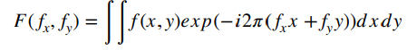
OVERVIEW OF THE ACTIVITY
The Fourier Transform is a mathematical method that permits the investigation and comprehension of a signal's frequency characteristics. It is often used in image processing to transform images from the spatial domain to the frequency domain. [1] To calculate the Fourier transform (FT) of a two-dimensional signal f(x,y), we use the formula, where fx and fy are the spatial frequencies along the x and y axes, respectively. [2]
In this activity, however, we don't have to limit ourselves to this specific integral or function, and we are free to investigate the simulations themselves. Let's look into the widespread application of the Fourier Transform (FT) in image processing!

Slide 3
OBJECTIVES
Understanding the Fourier transform and its application in image processing
Transforming images between the spatial and frequency domains
Applying FT, FFT shift, and logscale shift to various binary images
Comparing the resulting Fourier Transforms for different apertures and aperture diameters
Applying FT and inverse FT to grayscale square image
Exploring the concepts of Convolution as a simulation of an imaging system and Correlation in template matching

Slide 4
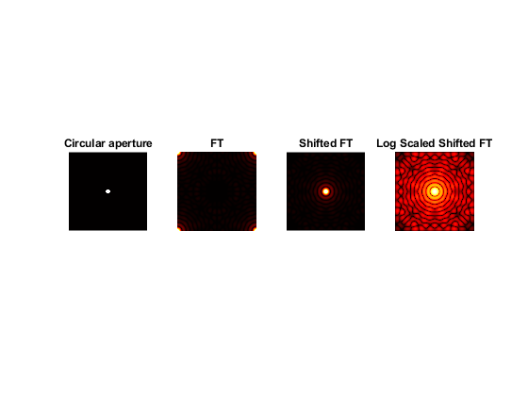
2.1 FAMILIARIZATION WITH DISCRETE FT
The first part of the exercise allowed us to become familiar with the Discrete Fourier Transform (DFT) by applying it to a binary image, which in this case is the circular aperture in Figure (a). After creating this binary picture with MATLAB's built-in functions, we Fourier transformed it with the fft2 function to convert its spatial domain representation to its frequency domain representation. However, the transformed image is a complex-valued image, which means that, as shown in figures (b), the high frequency components were concentrated at the image's corners rather than in the image's center. This is because, by default, the output of fft2 in MATLAB places the zero frequency component at the top left corner, so for easier visualization, we shifted the zero-frequency component of the Fourier transform to the center of the matrix using the fftshift function. [3] Lastly, we used the log and rescale functions to improve the visibility of the Fourier spectrum by taking the logarithm of the absolute value of the Fourier transform, and rescaling the values to be on a logarithmic scale. [4] Thus, Figure (d) shows the visual representation of the frequency content of the circular binary image. From here we can see that the matrix's brighter regions represent higher frequency components, whereas the matrix's darker regions represent lower frequency components.
Figure 1
(a) (b) (c) (d)

Slide 5
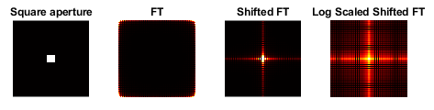
OTHER FT OUTPUTS USING DIFFERENT SHAPES OF APERTURE
Figure 2
(a) (b) (c) (d)

Slide 6

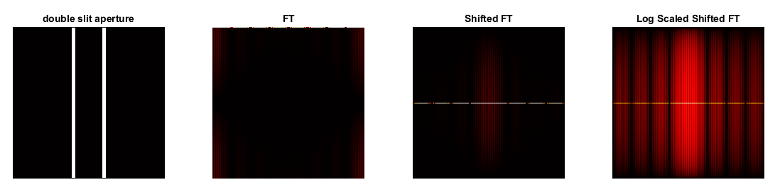
Figure 3
(a) (b) (c) (d)
Figure 4
(a) (b) (c) (d)

Slide 7
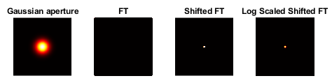
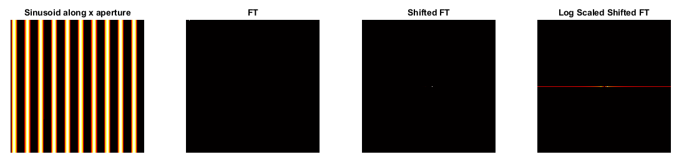
Figure 5
(a) (b) (c) (d)
Figure 6
(a) (b) (c) (d)

Slide 8
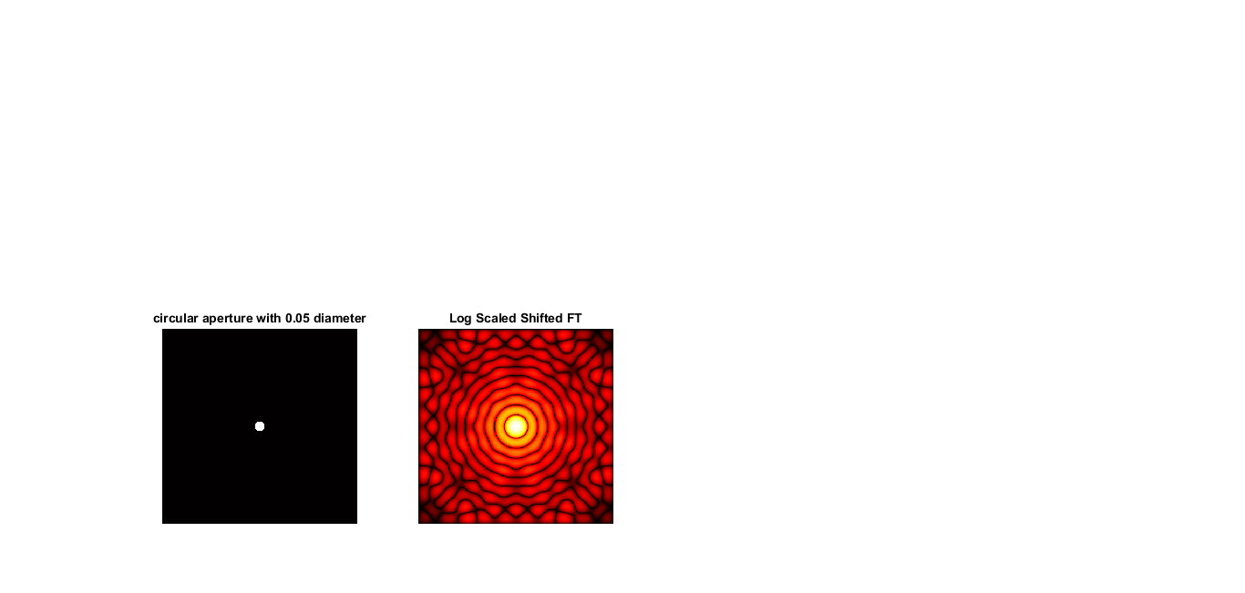
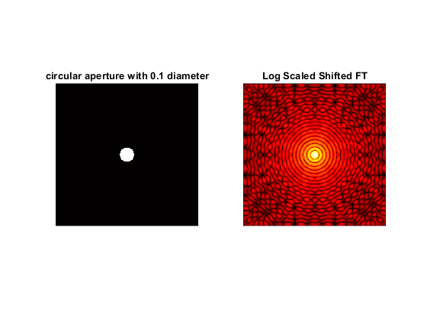
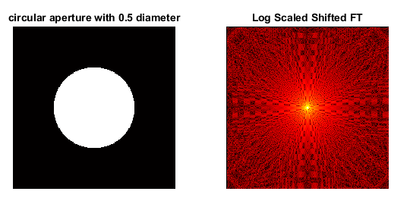
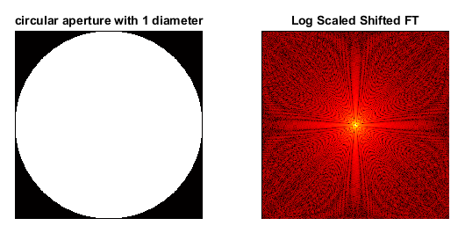
What if we vary the diameter of circular aperture?
Figure 7
(a) (b)
Figure 8
(a) (b)
Figure 9
(a) (b)
Figure 10
(a) (b)
Here, we can observe that adjusting the aperture's diameter affects the log-shifted FFT of the diffused pattern. The lowest diameter (0.05) has the least amount of high-frequency information in its pattern, while the biggest diameter (1) contains the most high-frequency information. We can conclude that increasing the diameter of the circular aperture permits more spatial frequencies to flow through it, resulting in a larger range of spatial frequencies in the diffraction pattern. The opposite is true if the diameter of the circular aperture is decreased.

Slide 9
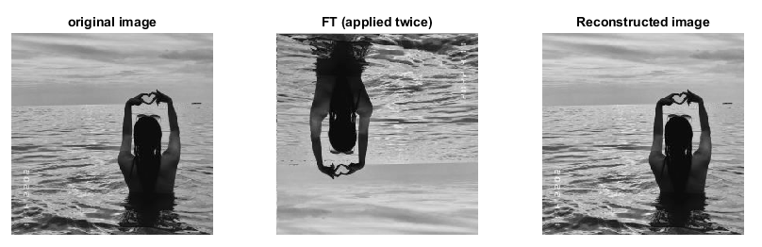
IMAGE RECONSTRUCTION USING FT
Figure 11
(a) (b) (c)
Here, a square RGB image was converted to grayscale using the built-in rgb2gray function, and the Fourier Transform was applied twice to assess the image's frequency content at different scales and levels of detail. Figure b shows that the resulting image was inverted or flipped upside down. This is anticipated since it is a DFT property that when DFT is applied twice to the same input data, the original signal gets inverted. (circularly). Refer to [5] and [6] for references. Since Fourier Transform is a reversible process, we anticipated that the reconstructed picture, shown by Figure (c), would be identical to the original grayscale image. [7]

Slide 10
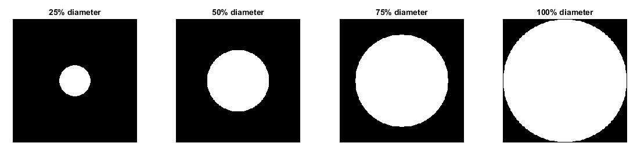
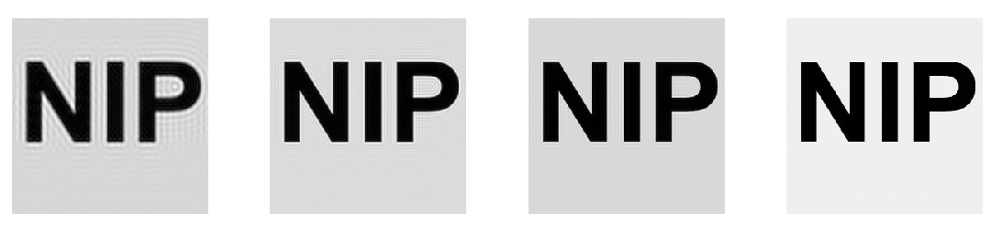
2.2 SIMULATION OF AN IMAGING SYSTEM
Figure 12
(a) (b) (c) (d)
(e) (f) (g) (h)

Slide 11

ON SIMULATING IMAGING SYSTEM
In the second part of the activity, we simulated an imaging system using Fourier Transform convolution. Integrating between two 2-D functions f and g yields the following convolution formula: In lieu of dealing with this integral, we multiplied 2 FTs in that two functions, which in this instance are the aperture and the letters NIP, and inverted FT the resulting image, yielding the same result as convolution. We applied it with diameters of 25%, 50%, 75%, and 100% of the diameter of the array's width. The resulting images were shown on the slide preceding this one. Observing these images, we can infer that a smaller aperture diameter, such as 0.25, will result in more aggressive filtering of high spatial frequencies outside the circular aperture, resulting in a blurrier image with a bigger circular zone of increased contrast. While a larger aperture diameter, such as 1.0, will result in a less aggressive filtering of high spatial frequencies outside the circular aperture, resulting in a less blurred image with a smaller circular zone of increased contrast.

Slide 12
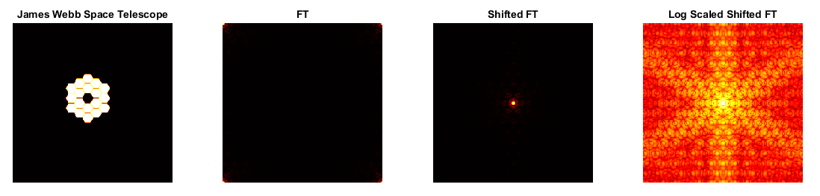
SIMULATION OF STAR IMAGE WITH JAMES WEBB SPACE TELESCOPE
Figure 13
(a) (b) (c) (d)
Similar to what we did in the first part of this activity, we converted this JWST image to grayscale, computed the Fourier Transform of it using the built-in fft2 function in MATLAB, shifted the FT using fftshift to better visualize the image, as seen in (c), and then enhanced the visibility of the smaller values through rescale and log functions, as shown in (d). The resulting log scaled shifted FT image shows how a single star would appear in a JWST image. However, it is essential to remember that stars are considered point objects, which lack a defined size, therefore the picture of a star in actuality would not be seen in the same manner as a larger object with more structure.

Slide 13
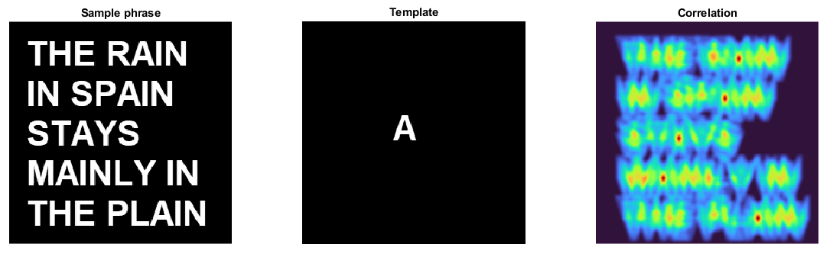
2.3 TEMPLATE MATCHING USING CORRELATION
Figure 14
(a) (b) (c)
Here, we searched the letter A, which served as our template, within the bigger image with the sample phase: THE RAIN IN SPAIN STAYS MAINLY IN THE PLAIN. We put two grayscale pictures into MATLAB, then applied FT using the fft2 function to each, resulting in a frequency domain representation of each image. We then obtained the complex conjugate of the FT of the template. And this complex conjugate was then multiplied to the FT of the sample phrase. The inverse FFT is then applied to the resultant product to generate the spatial domain representation of the correlation result; the resulting picture was then shifted to move the zero-frequency component to the image's center for improved visibility. The resulting correlation image is displayed in figure (c) above. It is evident that the correlation highlighted the letter A inside the image's text. The placement of the letter A coincides with the red dots or peaks. These vibrant red regions suggest a strong connection between the template A and the sample picture.

Slide 14
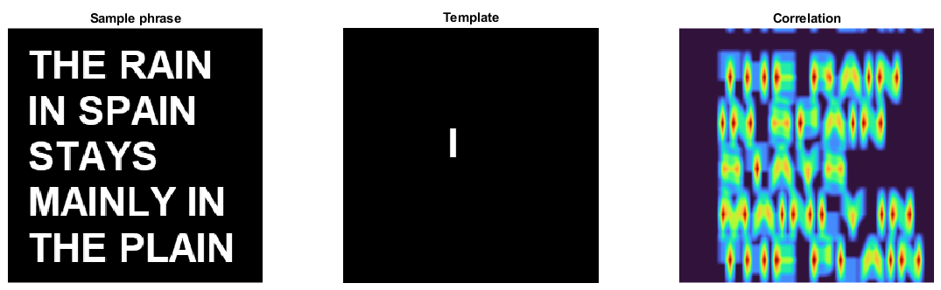
Figure 15
(a) (b) (c)
This is similar to the preceding slide, with the letter I serving as the template. The resulting image, shown in (c), displays a similar pattern of high values in locations where the template fits the sample phrase's pattern. However, correlation values are lower than in the first case with A as the template. This is due to the various vertical lines resembling those on the template. This implies that the letter A is a better match than the letter I for the pattern in the example sentence.

Slide 15
REFLECTION
I found this activity really enjoyable, particularly the coding part. Unlike in the last activity, I believe I had a better grasp of MATLAB in this one, but I still encountered errors at times. It was also much simpler to code than the first Activity. Seeing the predicted outcomes for each image inspired and motivated me to move on to the next one. I initially doubted some of my results, but was relieved to find out that my classmates had similar results. Lab hours really helped me finished this. Also special thanks to Mar Princer who helped me with the other codes and offered me a copy of his Canva-made JWST (credits and a big shout out to you). If trying various binary images except for the required image which is the circular aperture, then I think I deserve a bonus points or at least a perfect score. So, in short, I’ll give myself a solid 10/10 :P

Slide 16
REFERENCES
[1]https://byjus.com/maths/fourier-transform/#:~:text=Fourier%20Transform%20is%20a%20mathematical,%2C%20RADAR%2C%20and%20so%20on.
[2] Lab manual
[3] https://www.mathworks.com/help/matlab/ref/fftshift.html
[4] https://www.mathworks.com/matlabcentral/answers/128367-show-fourier-transformed-image-in-different-scale
[5] https://dsp.stackexchange.com/questions/54864/performing-dft-twice-on-an-image-why-am-i-getting-an-inverted-image
[6] https://dsp.stackexchange.com/questions/29866/fourier-transform-of-a-fourier-transform/29870#29870
[7] https://www.cv.nrao.edu/~sransom/web/A1.html
[8] - https://www.mathworks.com/matlabcentral/answers/477280-different-colormaps-for-subplots

Slide 17
End

